Slide 1

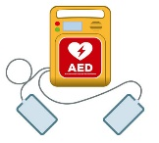
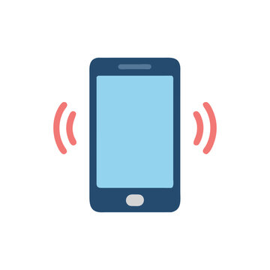


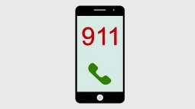
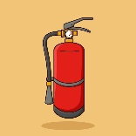
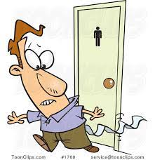

Wellness:
Does everyone feel well and focused?
PLEASE place your phones on
vibrate or silent.
AED/CPR:
No AED’s on the property - call 911
Security is CPR Trained; “Are there any volunteers?”
We are in Landmark 4-7:
In case of Emergency, exit through the doors at the rear or to the right of Landmark.
Continue through the doors marked ‘Washington Ave’.
Leave the hotel via the glass doors and cross the street to the American Center.
Natural Disaster:
If a Natural Disaster occurs, please shelter in place in the Landmark rooms, or the Gateway underground access.
In case of a fire, DO NOT USE THE ELEVATORS
Telephone:
In an emergency, please call 911;
We are located at :
800 Washington Avenue.
Any other issues dial: #5959 for Hotel Security.
Fire Extinguishers:
There are numerous Fire Extinguishers located
throughout the Hotel & Conference Center.
RUN – HIDE – FIGHT
Please assess your situation and surroundings.
If directed, go towards the American Center
HAVE A MENTAL PLAN
Bathrooms;
2 located to the right of Landmark 4-7
and to the left of Landmark 1-3

