Slide 1
How to Find and Use the UA First Step Form

Slide 2


Slide 3
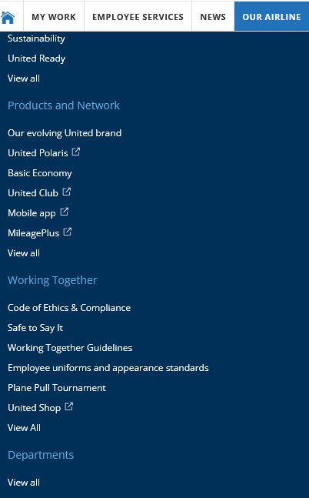
Where is the Form?
Flying Together
  Our Airline
    Departments
    View all
The form is also
available through
the IAM Website

Slide 4

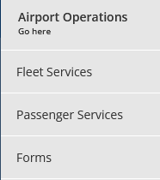
Where is the form?
Labor Relations
  In This Section
Airport Operations
  Forms

Slide 5
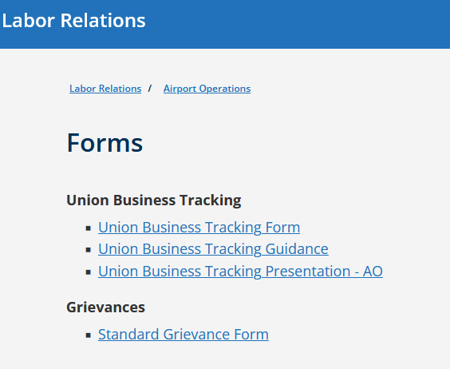
Where is the Form?
Forms
Grievances
Standard Grievance Form

Slide 6
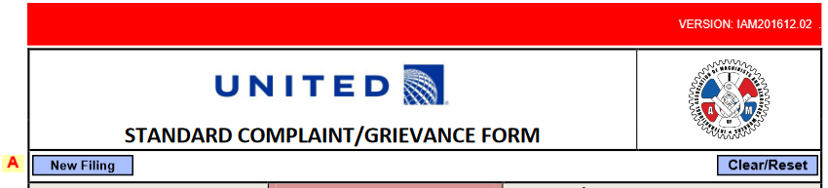

How to fill out the Form
Click on “New Filing”
Is your issue
Individual (Disciplinary)
Contract

Slide 7
How to fill out the Form
Enter your Employee uID (Numbers Only)
Enter your 5-digit LOC (Location Code, i.e ORDCG, PHLCS, SFOJG, etc)
Enter your Last Name, First Name, Middle Initial (Not Required) and Current Classification (i.e RSSR, CSR, RSE, LRSE)
You can include up to five total employees on a single form. If there are more than five involved, you must fill out another form.

Slide 8


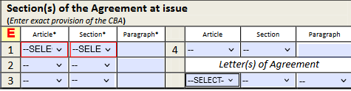
How to fill out the Form
Select the Applicable CBA
via the dropdown menu
Enter the Article, Section
and Paragraph
If it is from a LOA, use the Letters
Of Agreement Section

Slide 9
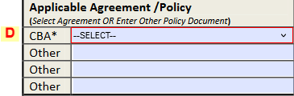
How to fill out the form
If your Grievance is related to other policies
such as Attendance, use the “Other” section

Slide 10
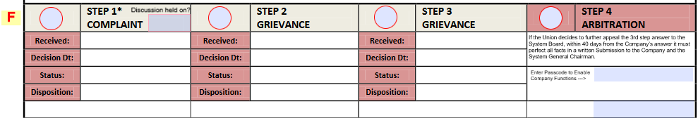
How to fill out the form
The rest of this section will
Automatically become filled out
Click the Level of Grievance
(Step 1)
You must include the Date you had a verbal discussion!!!

Slide 11
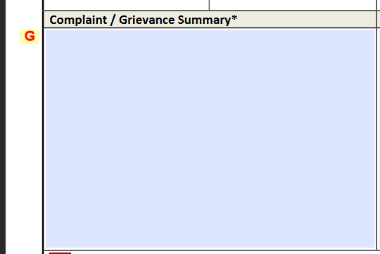
How to fill out the Form
Write a summary of
the Grievance
When using an article in the contract, make sure to use a catch-all phrase, such as “Including, but not limited to,” or “all others that may apply.”

Slide 12
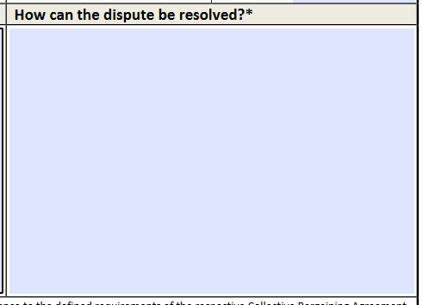
How to fill out the Form
What specific remedy can be sought?
How can the issue be resolved?
Example:
  If the remedy is monetary in nature, include the phrase, “applicable rate.”
ALWAYS ASK THAT THE GRIEVANT BE MADE WHOLE

Slide 13
How to fill out the Form
Confirm your Acknowledgement This is your electronic signature

Slide 14

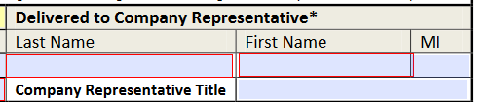
How to fill out the Form
Fill out the name of the
person submitting the form
Fill out the name of the
Management Employee
the grievance is being
submitted to and their title

Slide 15
How to fill out the Form
Once everything is completed
Check your form to make sure
it is all correct and accurate
Go to the top of the page
Save the Document as a PDF
Email to appropriate recipients, including but not limited to:
  Management, Local Committee, AGC, etc.
Or Print the Document to provide In-Person

